Slide 1
SSW-810: Software Engineering Tools and Techniques
Iteration
Dr. Raz Saremi
Software Engineering
School of Systems and Enterprises
This Lecture is based on material from Prof. Jim Rowland

Slide 2
Acknowledgements
This lecture includes material from
“How to Think Like a Computer Scientist: Learning with Python 3 (RLE)”, Peter Wentworth, Jeffrey Elkner, Allen B. Downey, and Chris Meyers,
http://openbookproject.net/thinkcs/python/english3e/
And
“Introducing Python”, Bill Lubanovic, ISBN-13: 978-1449359362
http://proquest.safaribooksonline.com/book/programming/python/9781449361167

Slide 3

Today’s topics
Sequences and Iterators
for loops
range()
while loops
Generators

Slide 4
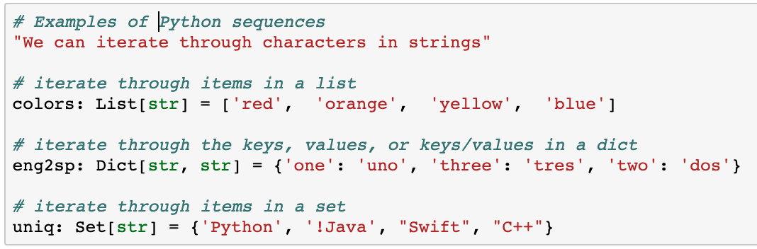
Sequences and iterators
Python supports several types of sequences
Both ordered and unordered collections of items
Sequences support iterators to iterate over the items
Examples of Sequences:

Slide 5
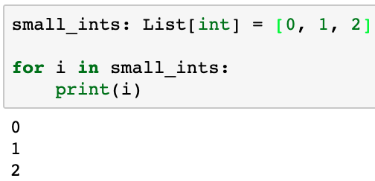
Iterating through the items in a list
Lists are ordered so the order is predictable
Software people like to start at 0, not 1
i gets the first, then each subsequent value of small_ints

Slide 6
Program flow: for loop
More items in the sequence?
for item in sequence:
Statement_{1..n}
Statement_{n+1}
False
True
Assign next item to loop variable
Statement_{1..n}
Statement_{n+1}

Slide 7
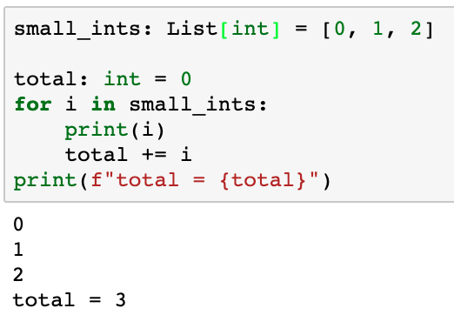
Iterating through the items in a list
Let’s calculate the sum of the values in small_ints
Iterate through the values from first to last
total will track the running total. Be sure to initialize it properly!
What if small_ints is empty?

Slide 8
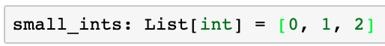
Range of integers
Lists are very powerful, but what if we want the first 1000?
Other languages use counters
/* C/C++ for loops */
for (i = 0; i < 1000; i++) {
cout << i;
}

Slide 9
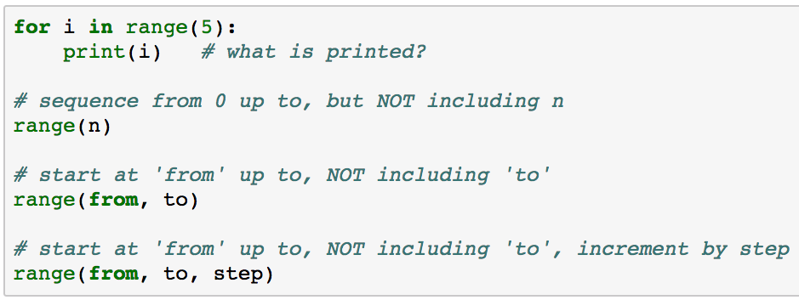
range(): a new sequence type
for loops iterate over sequences
range() returns a sequence that supports iteration
From 0, up to, but not including n happens frequently in Python

Slide 10
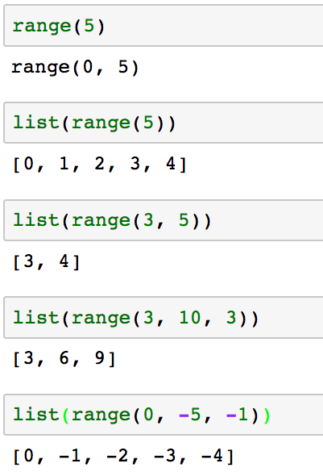
range(from, to, step)
range returns a sequence
You can see the values in the range by creating a list from the sequence

Slide 11
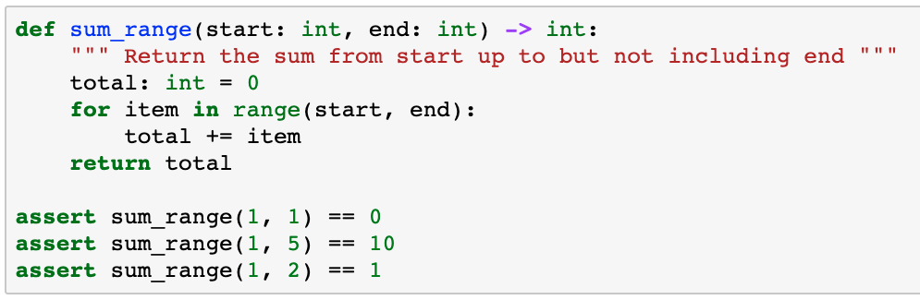
Write a function…
… to calculate the sum of a range of integers
0 ???
Why not 1?

Slide 12
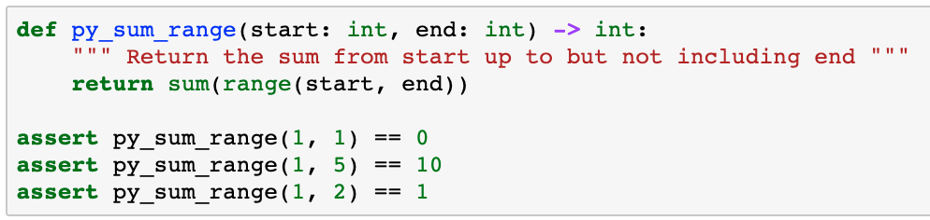
Write a Pythonic* function
Write a Pythonic function to calculate the sum of a range of integers from start, up to, but not including end
* Writing Pythonic code means to think about how Python works and take advantage of built-in functionality, even if it’s different from other programming languages

Slide 13
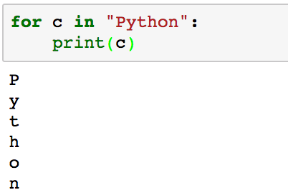
For loops and strings
Strings are sequences too!
We can use for loops with strings (or any sequence)

Slide 14
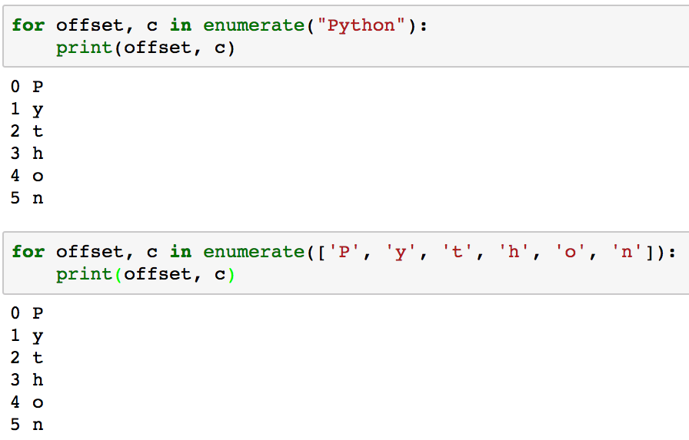
enumerate() and sequences
enumerate is a convenient way to assign an offset to an item in a sequence

Slide 15
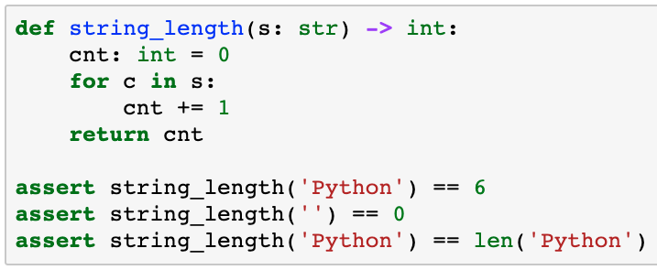
Write a function: string_length(str)
Use a for loop to calculate the length of a string
What happens if the string is empty?
The Pythonic solution is len(s)

Slide 16
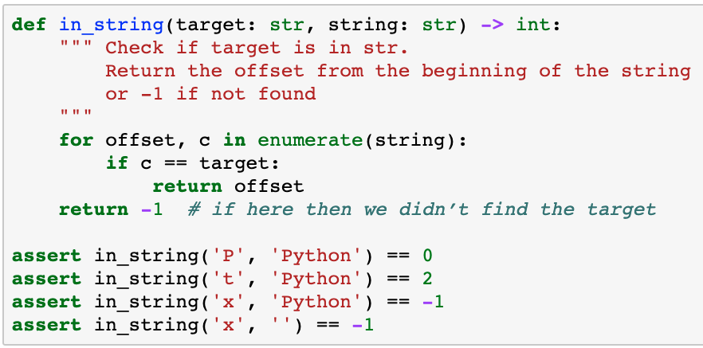
Write a function: in_string(target, string)
Use a for loop to look for a character in a string

Slide 17
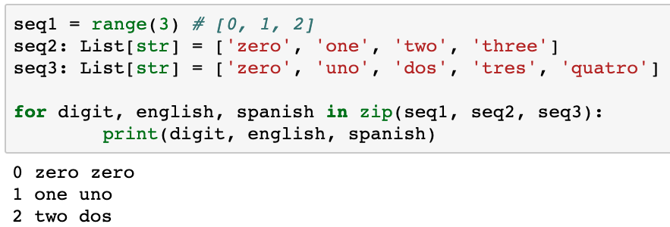
zip(*sequences)
zip helps you to iterate through multiple sequences
zip(*sequences) stops after the shortest sequence is exhausted
foo(*args) takes any number of arguments

Slide 18
Operations on sequences
Python provides built-in operations for all sequences
How would you implement these operations with loops?
Operation | Description | Example
len(s) | Return the number of items in the sequence | len(‘hello’) == 5 len([‘a’, 1, 3.4]) == 3
min(s) | Return the min value | min(‘hello’) == ‘e’ min([1, 3.2, 7]) == 1
max(s) | Return the max value | max(‘hello’) == ‘o’ max([1, 3.2, 7]) == 7
value in s | Return True if value is in s else return False | ‘e’ in ‘hello’ is True 3.2 in [1, 3.2, 7] is True
value not in s | Return True if s is not a member of s else return False | ‘x’ not in ‘hello’ is True 2 not in [1, 3.2, 7] is True

Slide 19
More type hints
Type hint | Semantics | Examples
Any | Value of any type | v1: Any = 3 V2: Any = “hello world”
Optional[type] | Value of type or None | Optional[int]
List[type] | List of values of type | l1: List[int] = [1, 2, 3] l2: List[str] = [‘hello’, ‘world’] l3: List[List[int]] =[[1, 2], [3, 4, 5]] L4: List[Any] = [1, ”two”, 3.14]
Sequence[type] | Arbitrary sequence of type | “Hello world” [1, 2, 3] {‘one’: 1, ‘two’: 2, }

Slide 20
While loops
while loops offer another way to loop
while conditional:
statement_{1..n}
statement_{n+1}
Conditional
False
True
Statement_{1..n}
Statement_{n+1}

Slide 21
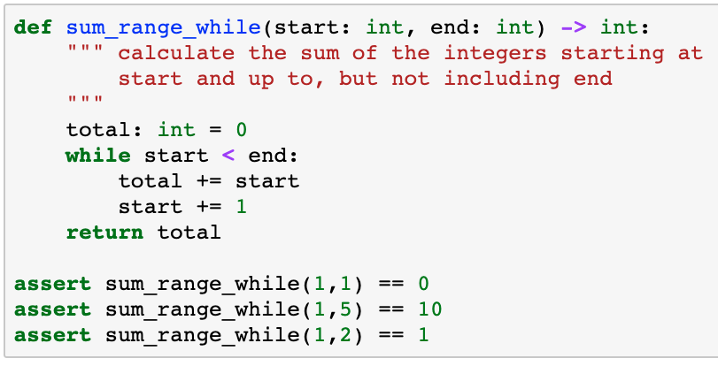
Write a function…
… to calculate the sum of a range of integers
What if start >= end?

Slide 22
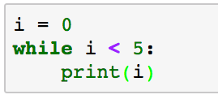
Beware of infinite loops
Programs do exactly what they are told, not necessarily what we want
We may go into an infinite loop if we’re not careful with while loops
What happens if I do:
Always verify that the conditional becomes False so the loop terminates
The while loop prints 0 until you interrupt the program. Why?

Slide 23
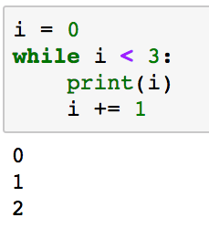
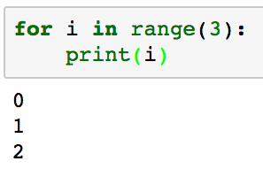
while loops
while loops are more flexible than for loops
But while loops may require more code

Slide 24
When to use for and while
If you are looping over a sequence, e.g. a range, a list, a string, … then a for loop is probably best
If you know how many iterations in advance, then a for loop is probably best
If you must loop while some condition is True/False, then a while loop is probably best
If you need a loop with a test in the middle or end, then a while loop is probably best, but a for loop may work as well
There’s no right or wrong answer. It’s just a matter of style. Choose the solution that makes your code easier to read, understand, and maintain.

Slide 25
Break out
Sometimes you want to break out of the middle, rather than the top, of a loop
while conditional:
statement_{1..k}
if condition:
break
statement_{k..m}
statement_{n}
break leaves the loop and execution moves to the first line following the while block

Slide 26
break out
Condition₁
False
while condition₁:
statement_{1..k}
if condition₂:
break
statement_{k..m}
statement_{n}
True
Statement_{1..k}
Condition₂
True
False
Statement_{k..m}
Statement_{n}

Slide 27
Controlling the while loop
Flags for conditional expressions are one solution but alternatives may be more concise
# loop until the user quits
flag = True
while flag:
if input(‘Quit?: ‘) == ‘y’:
flag = False
# loop until the user quits
while True:
if input(‘Quit?: ‘) == ‘y’:
break
Choose the alternative works best for the situation

Slide 28
Where to test?
Test at the top
while condition:
statement_{i..j}
Test in the middle
while True:
statement_{i..j}
if condition:
break
statement_{k..l}
Test at the bottom
while True:
statement_{i..j}
if condition:
break
Execute statement_{i..j} 0 or more times
Execute statement_{i..j} at least once: statement_{k..l} 0 or more times
Execute statement_{i..j} at least once

Slide 29
How many digits in a number?
Write a function to calculate the number of digits in a number
e.g. 100 has 3; 2354 has 4; etc.
Use // operator – floor division, e.g. 9 // 2 == 4
Start with the number and continue doing floor division by 10 until we run out of digits
for loop or while loop?
Don’t know the number of iterations in advance so a while loop is probably better

Slide 30
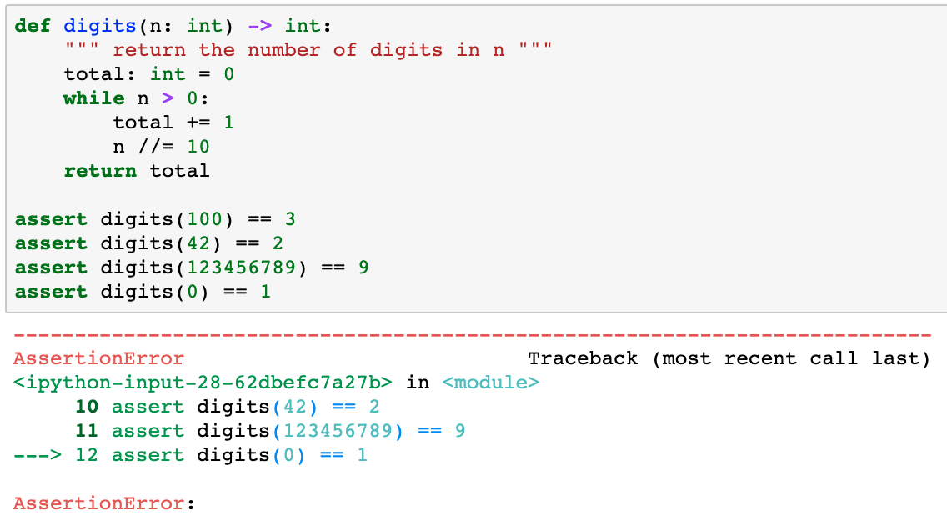
How many digits?
Test boundary conditions, e.g. 0

Slide 31
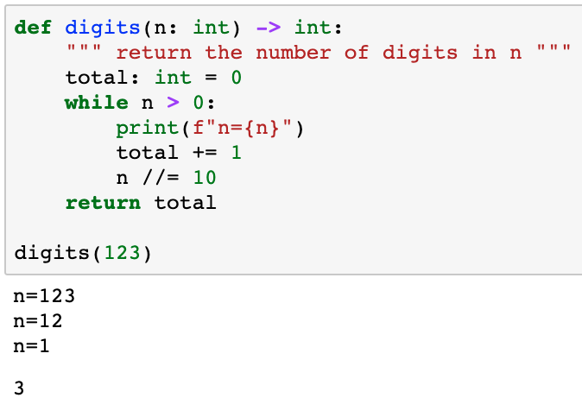
Debugging digits()
The print statement helps with debugging
digits(123) returns 3

Slide 32
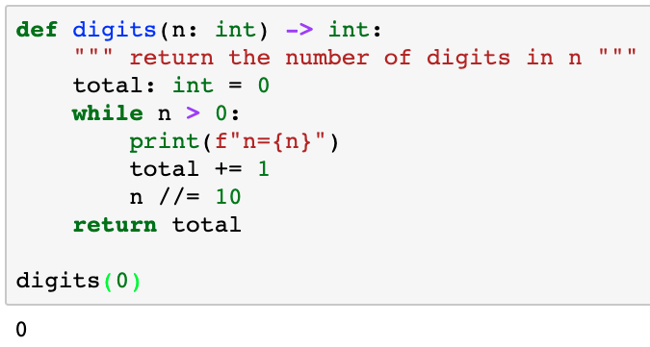
Testing digits()
What‘s wrong? digits(0) == 0 but should be 1
Wait! Why didn‘t the print statement print anything?

Slide 33
Testing digits()
Not entering the loop if n == 0. Just, change ‘>’ to ‘ >=‘
That will fix it!
Not so fast!!!
Walk through the logic by hand.
Will the condition ever be False?
No, 0 // 10 == 0
We’re stuck in an infinite loop!
Time for ^C
What‘s wrong? digits(0) == 0 but should be 1
Wait! Why didn‘t the print statement print anything?

Slide 34
Testing digits()
How can we fix the problem with 0?
Wait! What about negative numbers?
Work through the logic by hand…
-1 // 10 == -1 (infinite loop)
Solution is valid only for positive integers!
Add missing test cases for < = 0
What‘s wrong? digits(0) == 0 but should be 1
Wait! Why didn‘t the print statement print anything?

Slide 35
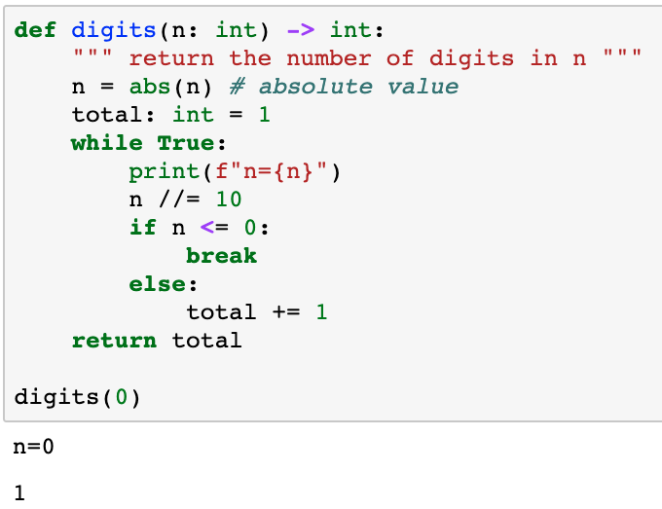
Debugging digits(0)
Sometimes we just need to start over and try a different approach
Exit from the middle of the loop rather than the top
This solution passes all of the previous tests…

Slide 36
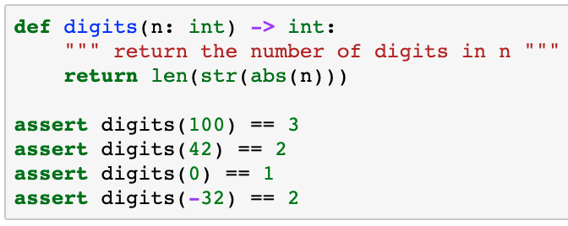
How many digits? Pythonic solution
Consider alternative solutions then choose the “best”
Readability/maintainability
Consistency
Being “too clever” may cause problems

Slide 37
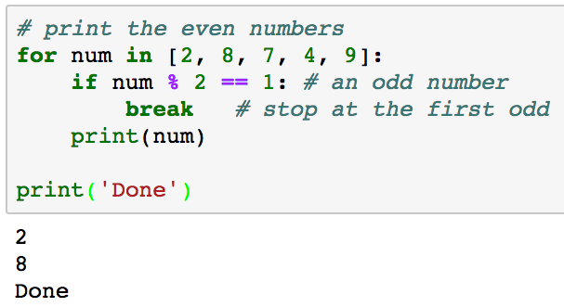
break out of for loop
Breaking out of a for loop is fairly unusual
Think about a different solution before committing to breaking out of a for loop

Slide 38
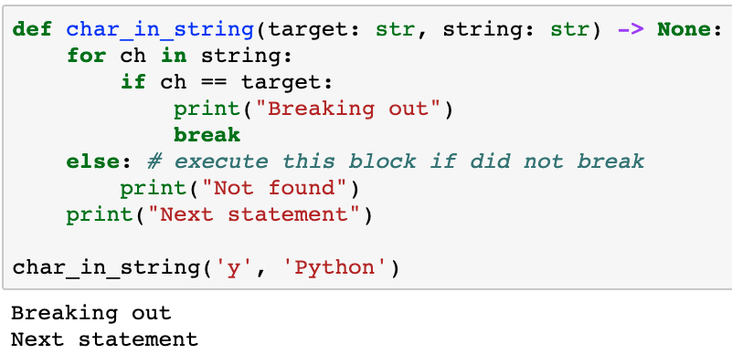
while/else, for/else
Python offers while/else and for/else statements
The else clause is executed if the loop terminates naturally, without break

Slide 39
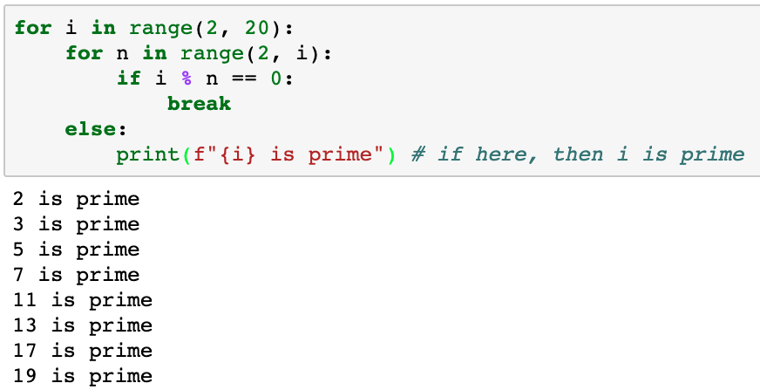
Using for/else
The else clause is executed if the loop terminates naturally, without break

Slide 40
continue
break exits the loop
continue skips the rest the loop and continues at the next iteration

Slide 41
continue
condition₁
False
while condition₁:
statement_{1..k}
if condition₂:
continue
statement_{k..m}
statement_{n}
True
statement_{1..k}
condition₂
True
False
statement_{k..m}
statement_{n}

Slide 42
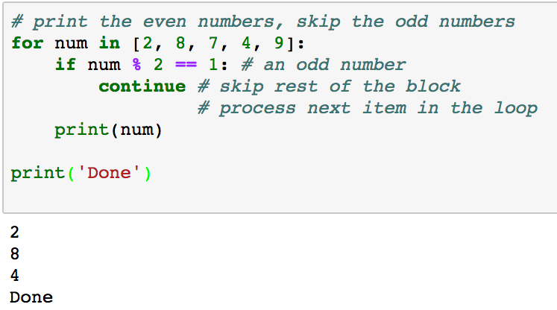
Continue to next item in for loop
Think about a different solution before committing to break or continue, but sometimes break/continue is best

Slide 43
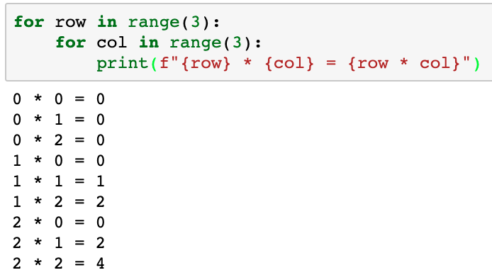
Nested loops
Nested loops are very common

Slide 44
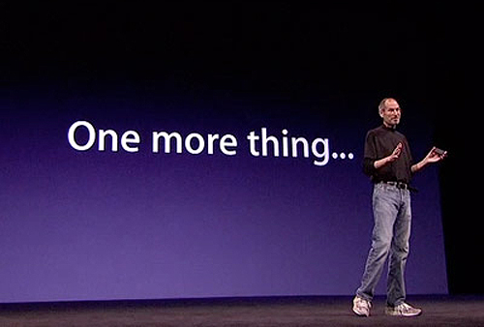

Slide 45
Generators
Generators create custom sequences with lazy evaluation
The generator creates the next item in the sequence on demand
Don’t create the next item until requested
Consider a system that collects data from an internet feed, e.g. the Twitter feed for Python tweets
for tweet in twitter_feed():
tweet.analyze()
We could read N tweets in advance and store them in a list or we can use a generator to get the next tweet
Generators are great for co-routines
cat file | filter1 | filter2 | filter3

Slide 46
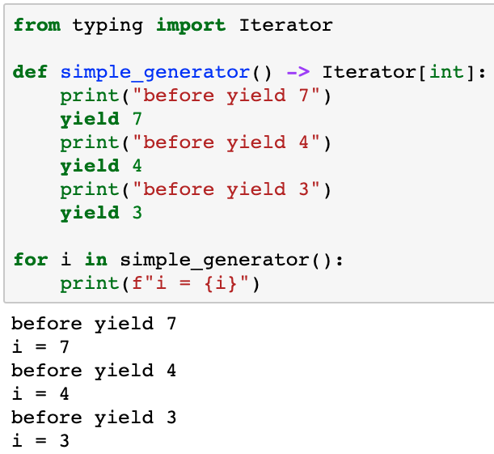
Writing generator functions
A generator looks just like any other function, except…
Generators include one or more yield expressions
Yield a sequence of int values
Yield 7 and wait for the next call
Yield 4 and wait for the next call
Yield 3 and wait for the next call
The generator ends on implicit or explicit return

Slide 47
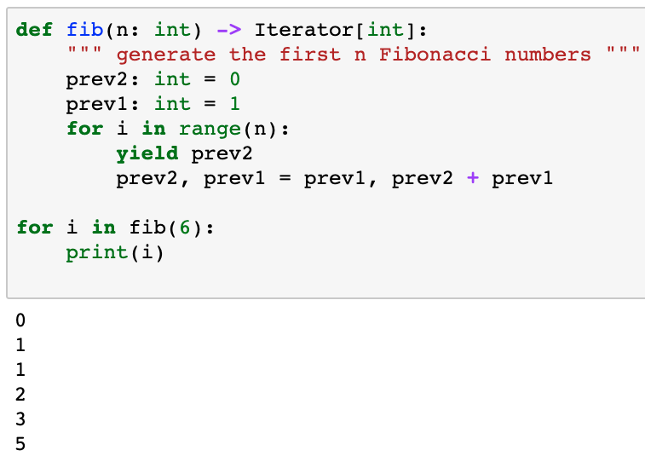
Writing generator functions
Yield ”returns” the value, but execution continues here on next call
The generator exits on implicit or explicit return
Parameters and local variables are maintained across subsequent yields until the function returns

Slide 48
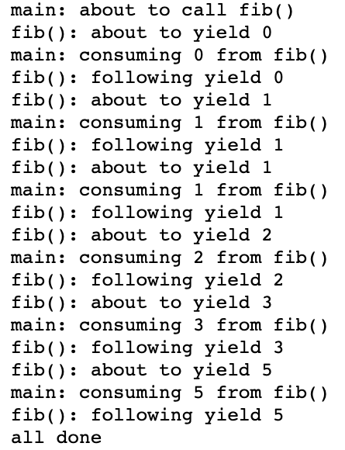
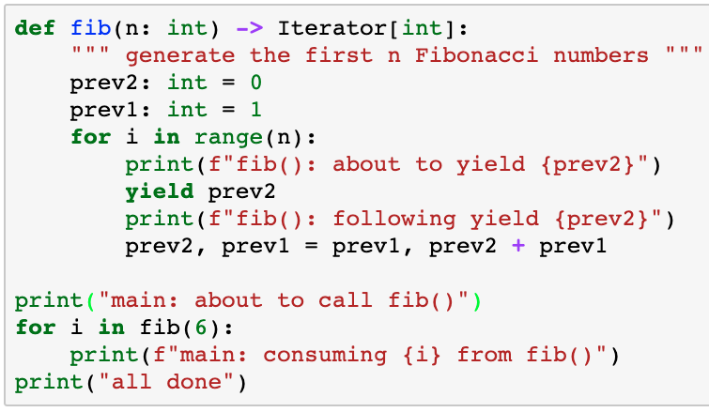
Running generator functions

Slide 49
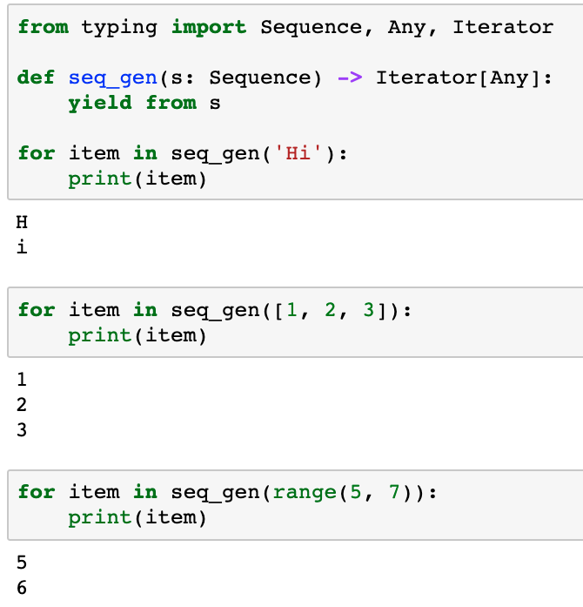
Yield from any sequence
This works for sequences of any type, e.g. strings, lists, tuples, …

Slide 50
More type hints
Type hint | Semantics | Examples
Sequence[type] | Arbitrary sequence of type | “Hello world” [1, 2, 3] {‘one’: 1, ‘two’: 2, }
Iterator[type] | A generator yielding a sequence of type | def integers() -> Iterator[int]: # generate a sequence of int values
Example:
def my_enumerate(seq: Sequence[Any]) -> Iterator[Any]:
Given a sequence of Any type, return a generator that yields value of Any type

Slide 51
Write a generator…
… that counts from 0 up to a limit and then back to 0
e.g. 0, 1, 2, 3, 2, 1, 0
How to start?
How to count up to limit?
range(0, limit + 1)
How to count down limit to 0?
range(limit – 1, -1, -1)
Wait… we can simplify that a little…
range(limit) # 0 to n – 1
range(limit, -1, -1) # n down to 0
Consume all values one by one then move to next statement

Slide 52
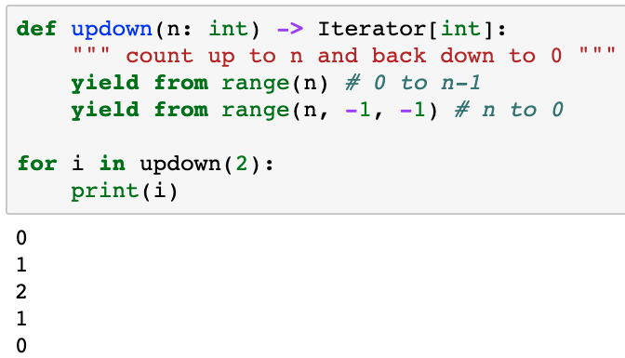
Write a generator…
Consume all values one by one then move to next statement

Slide 53
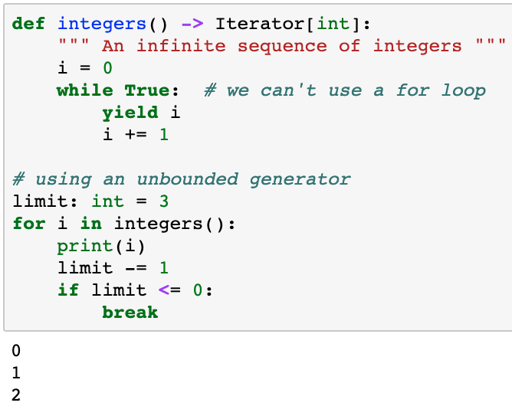
Unbounded generators
Yield the next integer for as long an anyone calls __next()
Need to limit the number of calls to avoid infinite loop

Slide 54
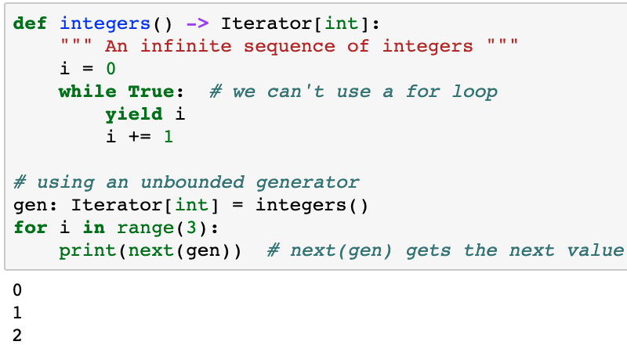
Generator next()
Wait!!! while True with no break? That’s an infinite loop!?!?
next() is called only when next value is needed, so yes, it’s an infinite loop, but not a problem
next(generator) gets the next value from a generator

Slide 55
When to use generators?
Any time you need a sequence
Generators are more efficient than prepopulating a list
While waiting for asynchronous events
Any time lazy evaluation makes sense
e.g. very large sequences
Any time you may need to read multiple lines from a file to retrieve a single entry

Slide 56

Questions?

